Slide 1
Nuclear Physics: An Engineering Perspective
Part I

Slide 2
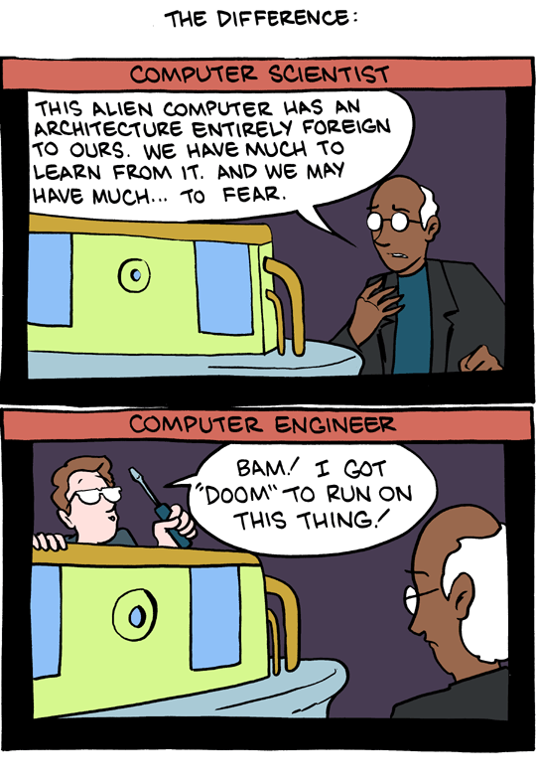
This is an engineering presentation.
Scientists try to discover how the world works.
Engineers try to make it work differently.

Slide 3
This is an engineering presentation.
I will be focusing primarily on the implication and applications of nuclear physics, rather than the underlying subatomic particle mechanisms.
This is somewhat unfortunate, because I don’t get to say things like:
“After electroweak symmetry breaking, the Higgsino becomes a pair of neutral Majorana fermions called neutralinos and a charged Dirac fermion called a chargino (plus and minus). These states finally mix with the neutralinos (photino and zino) and chargino (charged wino plus and minus) to form the predicted particles which are four neutralinos and two charginos (plus and minus each).”

Slide 4
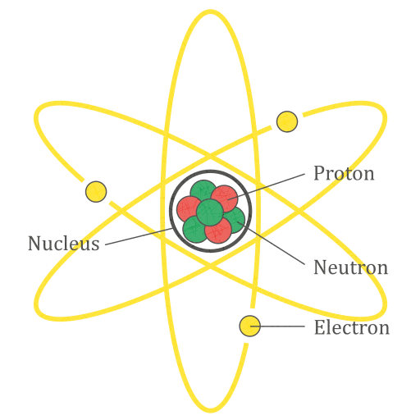
Atoms
Chemistry:
All about the electrons
Nuclear physics:
All about the nucleus

Slide 5
Atoms
There are four fundamental forces in the universe:
Strong nuclear force
Weak nuclear force
Electromagnetism
Gravity

Slide 6
Atoms
Strong nuclear force
Hold protons and neutrons together

Slide 7
Atoms
Weak nuclear force
Weird
Technically, it causes quarks to change flavor
There are 6 flavors of quarks:
Up
Down
Top
Bottom
Strange
Charmed
For example, neutrons are made up of an up quark and two down quarks

Slide 8
Atoms
Electromagnetic force
Like charges repel, opposite charges attract
Really important for chemistry

Slide 9
Atoms
Gravity
Meh

Slide 10
Chemistry
Focuses mostly on interactions between atoms
You have some protons with + charge, and some electrons with – charge
You can remove (or add) some electrons to make an ion
Etc.

Slide 11
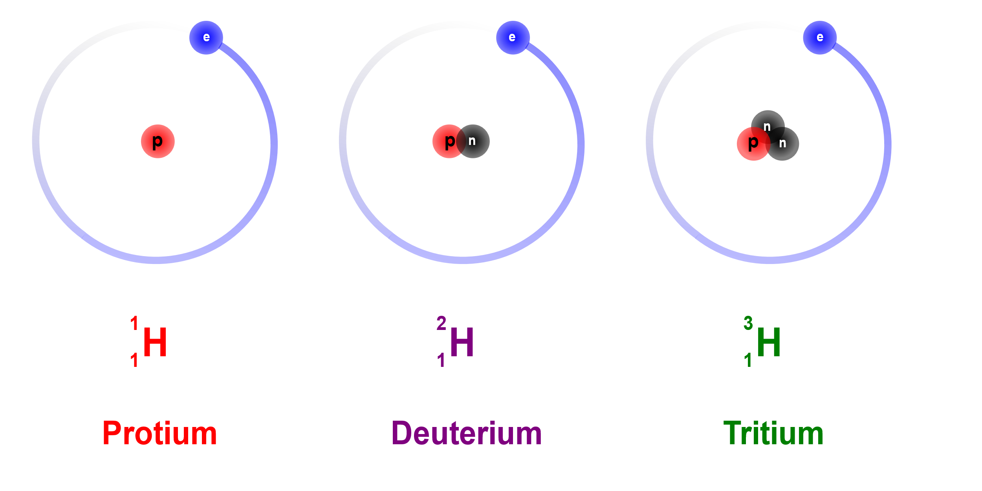
Hydrogen
As simple as it gets
Nucleus: a single proton
The proton’s charge is cancelled by an electron, to make it neutral
This is by far the most common form of hydrogen

Slide 12
Hydrogen
We’ve added a neutron!
Neutrons have similar mass to protons, but no charge
Chemically, this will behave about the same as normal hydrogen
It’s still neutral, same number of electrons

Slide 13
Terminology & Notation
Atoms with the same number of protons are the same element
Atoms of a certain element with different numbers of neutrons are isotopes of that element
“Protium” and “deuterium” are isotopes of hydrogen

Slide 14
Terminology & Notation
There’s a specific notation to let us tell isotopes apart
The letter(s) tell us what element it is
The subscript tells us how many protons it has
The superscript tells us the mass number
Protons + neutrons
(Electrons have negligible mass)
Mass Number
Protons
Element

Slide 15
Terminology & Notation
You might notice that this is redundant
“Element” and “number of protons” are basically the same thing
Thus it’s common shorthand to leave off the subscript
This is fine

Slide 16
Terminology & Notation
Isotopes are pronounced as the name of the element followed by the mass number
And sometimes written that way
“Hydrogen-2”
Note: the “special” names, such as protium and deuterium, are unique to hydrogen. We don’t name isotopes of other elements like that.

Slide 17
Terminology & Notation
One proton
Two neutrons
One electron
(Still neutral)
Hydrogen-3

Slide 18

Decay
${}_{1}^{1}H$ and ${}_{1}^{2}H$ are stable; they’ll just sit around forever
${}_{1}^{3}H$, though, is unstable – it will decay
Specifically:
Via the weak force, one of the neutrons turns into a proton
The process releases an electron and an electron antineutrino
For the time being, we don’t really care about the electron antineutrino
${}_{1}^{3}H\overset{→}{}{}_{2}^{3}{He}+e^{−}+\overline{{\text{ν}}_{e}}$

Slide 19

Decay
The electron flies out of the atom at high speed
This is called a beta particle, and the mechanism that produces it is called beta decay
Specifically, this is beta-minus ($β^{−}$) decay
There’s also $β^{+}$ decay, which releases a positron (antielectron) and an electron neutrino

Slide 20

Decay
High-speed free electrons (AKA “beta particles”) are called beta radiation
There’s another common type of particle radiation called alpha radiation
Rather than an electron, alpha particles are 2 protons and 2 neutrons stuck together
A ${}_{2}^{4}{He}$ nucleus

Slide 21
Engineering Time!
So how do we detect this radiation?
Alpha and beta rays (as well as some others) are ionizing radiation
That is, if a beta particle hits a neutral atom, it can ionize the atom
Give it an electrical charge

Slide 22
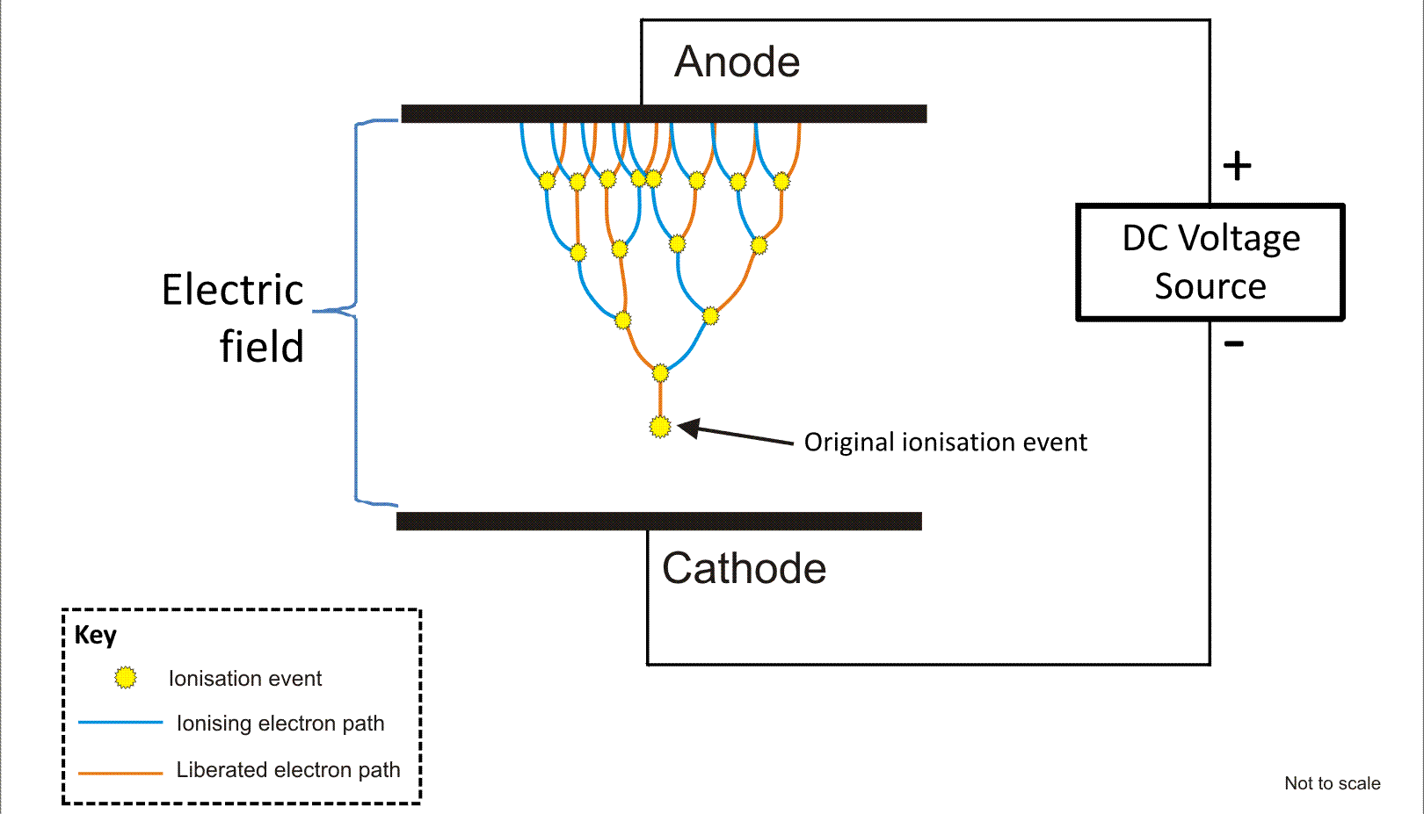
Engineering Time!
Suppose we have some gas between two metal plates with a voltage across them
Normally, the gas is neutral, and nothing much happens.

Slide 23

Engineering Time!
But when radiation ionizes a gas molecule, that molecule starts accelerating towards one of the electrodes
$$β^{−}$$

Slide 24
Engineering Time!
That ion hits other gas molecules and ionizes them, leading to an avalanche.
When all those ions get to one of the electrodes, they are detectable as a pulse of current

Slide 25
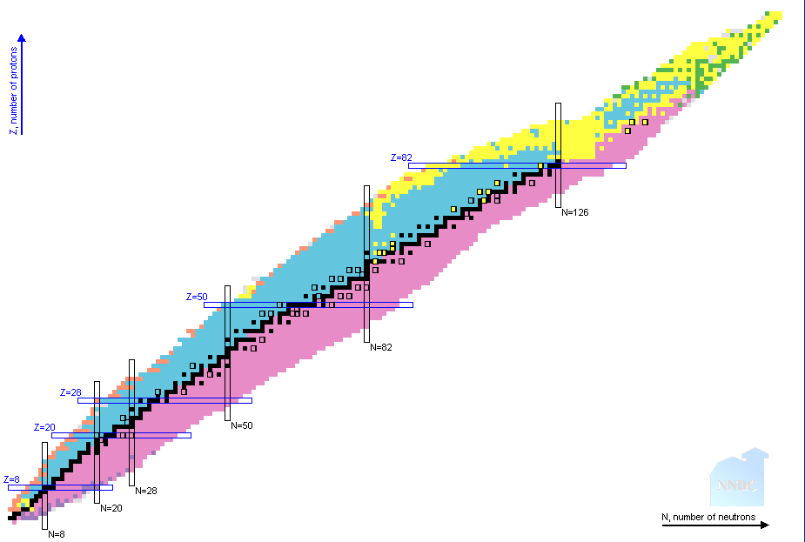

Table of Nuclides

